Slide 1
Advanced Stages in Data stage 8.5/8.7

Slide 2
Advanced Stages in Data stage 8.5/8.7
Transformer stage new functions and looping condition
Range lookup process
Enhanced Surrogate Key Stage
Slowly Changing Dimensions implementation
Database Connector stages
CFF Stage – Multi-Format Record Support
Z/OS File Stage
Netezza Integrations
Check Sum
Bloom Filter
Dataset Enhancements
Pivot Enterprise Stage
Any use, copying or distribution without written permission from UnitedHealth Group is prohibited.

Slide 3
Transformer stage new functions and looping condition
The ability to process input data in loop is a major new enhancement in the Transformer Stage .Each input row might result in multiple output rows.
You will find there is a loop test (which is a "while" condition in Loop Condition section) that controls how many times the output logic should be iterated over. The circled logic includes a new variable named "@ITERATION" which is a counter indicating what pass through the loop this is. One other item that will appear new are the Loop variables - basically the same as Stage variables, but these get evaluated each time through the loop. The rest of this logic is old hat ... basic sub stringing and calculations to delineate the record payloads. The test for Remaining Record <> "" allows us to exit the loop when all bytes in the string have been consumed.
Any use, copying or distribution without written permission from UnitedHealth Group is prohibited.

Slide 4
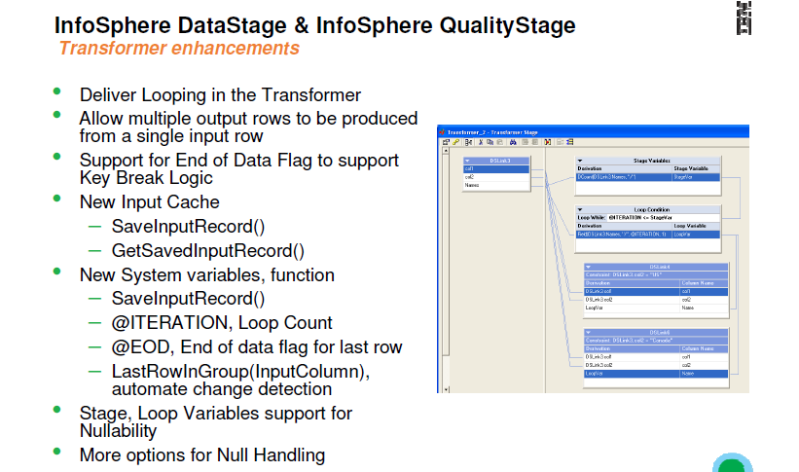
Transformer stage new functions and looping condition
Any use, copying or distribution without written permission from UnitedHealth Group is prohibited.

Slide 5
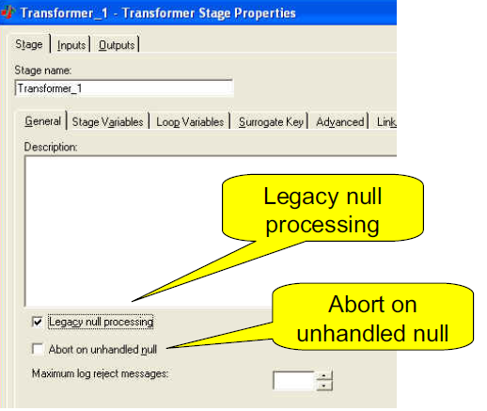
New features in existing stages
Transformer legacy null handling
Any use, copying or distribution without written permission from UnitedHealth Group is prohibited.

Slide 6
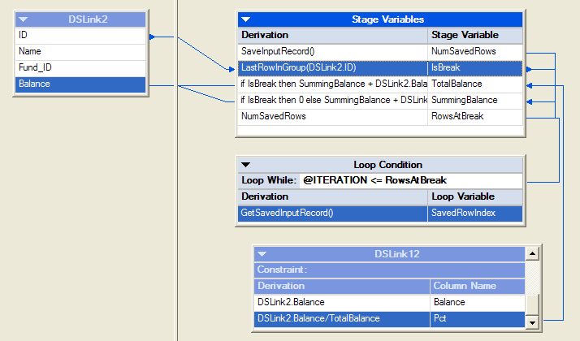
Transformer Stage Group Processing
Any use, copying or distribution without written permission from UnitedHealth Group is prohibited.

Slide 7

Lookup Stage – Range Lookup
Lookups with 1 input key and 2 table keys
  For example: Lookup all the records where input column transactionDate is between table column startDate and table column endDate.
Lookups with 2 input keys and 1 table key
  For example: Lookup all the records where table column transactionDate is between input column startDate and input column endDate.
Range options can be inclusive or exclusive
Range can be combined with regular equality lookup keys

Slide 8
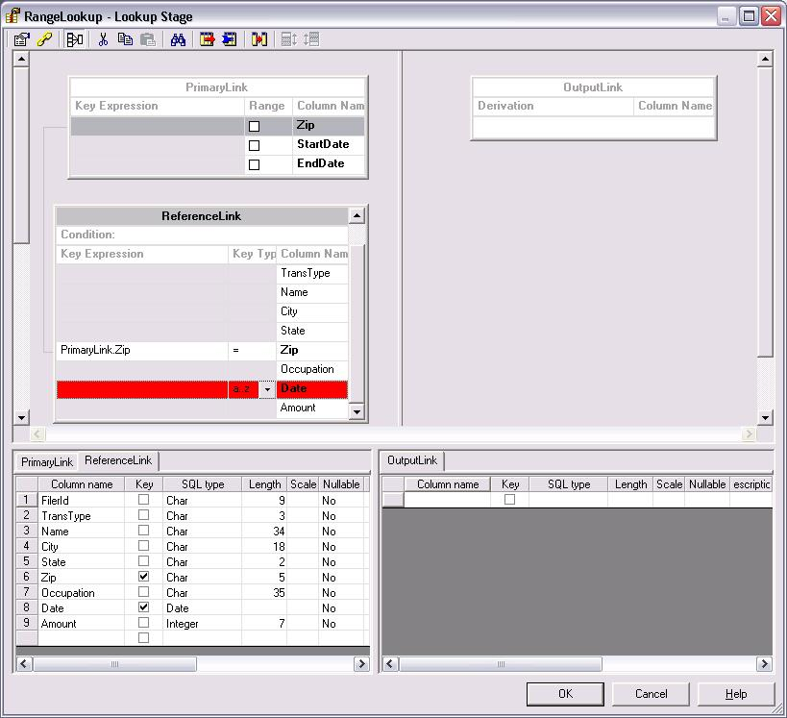
Lookup Stage – New Range Options
Range check box allows you to specify a range key for a 1 to 2 type range lookup
Key Type drop down allows you to specify a range key for a 2 to 1 type range lookup
Double clicking on the Key Expression field of a range key will bring up the Range Expression dialog

Slide 9
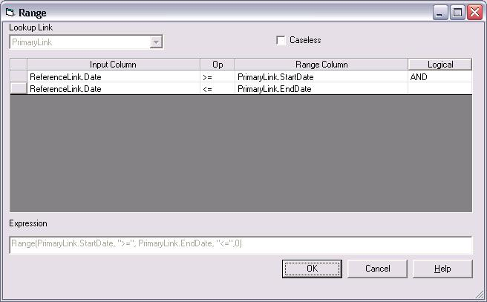
Transformation: New Range Expression Dialog
Column selection for the range key from the reference table
Column selection for the bounding columns from the primary input
Range expression operator drop down. Specifies whether the range bounds are inclusive or exclusive

Slide 10

Surrogate Key Management
New Engine Functionality
Exposed in 2 new stages and 1 old one
  Surrogate Key Generator
  Slowly Changing Dimension
  Transformer – Initialize(), GetNextKey()
How it works
  Uses built-in state files or DBMS sequences (DB2 & Oracle)
  Supports large integer (uint64) surrogate key values
  Can be used to discover surrogate key values which are already being used so that use of duplicate key values will be avoided
  Customizable block size to manage key gaps vs. performance

Slide 11
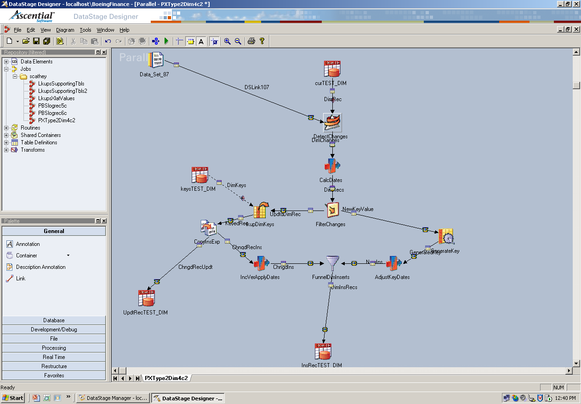
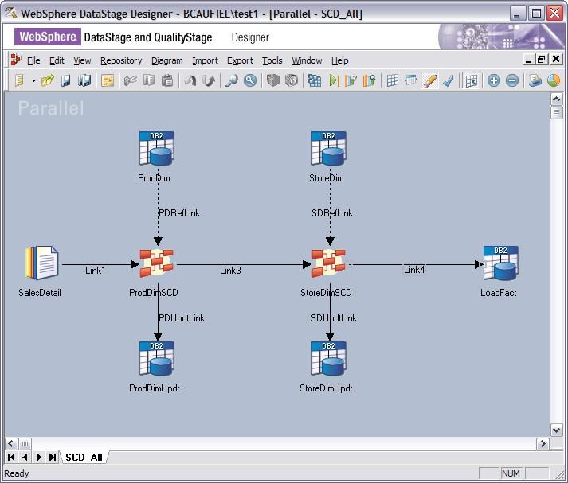
New Functionality to Support SCD
New engine capabilities
Surrogate Key management
Updatable in-memory lookups
New & enhanced stages
Surrogate Key Generator
Slowly Changing Dimension

Slide 12
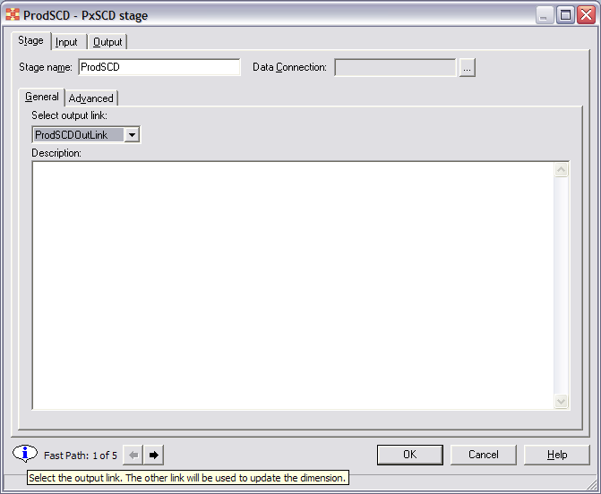
SCD - New Fast Path control
The new “FastPath” control has been created to help navigate among the 5 screens on which the user is most likely to need to enter information.
Hover the mouse icon over the “i” balloon for short contextual help.

Slide 13
SCD (cont.) - Identify the Output Link
The SCD stage produces two streams of output data
  Dimension Update link for updating the real dimension table
  Output link for data being passed on for further processing
This screen is used to identify the Output link

Slide 14
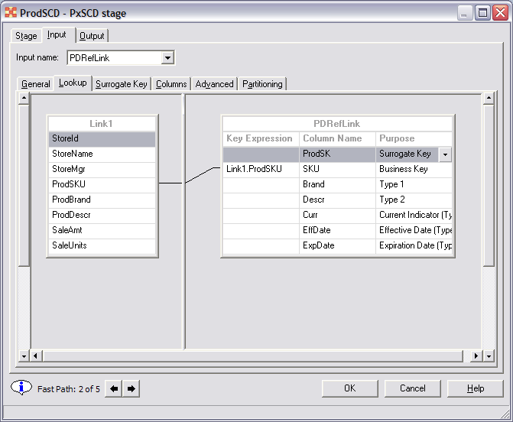
SCD (cont.) - Specify the Dimension Row, Purpose Codes
The second FastPath screen is used to specify the lookup condition. The matching creates an equality condition between the source and reference link columns.
This screen is also used to associate “Purpose Codes” to columns. This is a special column attribute only applicable to SCD processing. It tells the system how the column is used.

Slide 15
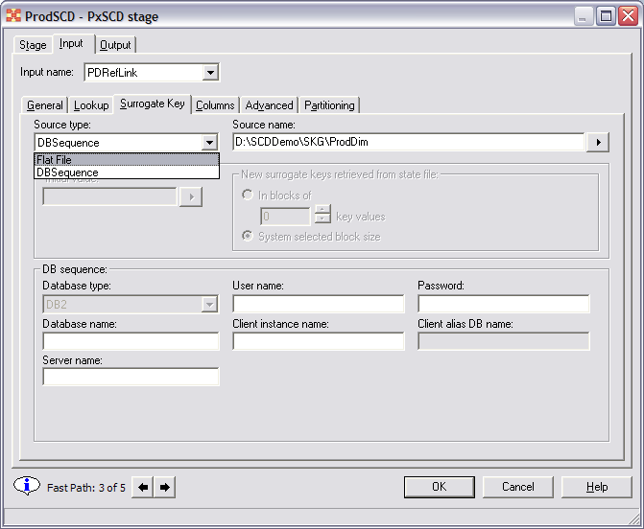
SCD (cont.) Using the Surrogate Key facility
The ability to use the surrogate facility is built into the SCD stage
A DataStage managed state file or DB sequence object can be used
Supply a state file or DB sequence name
Different options are available based on the source type

Slide 16
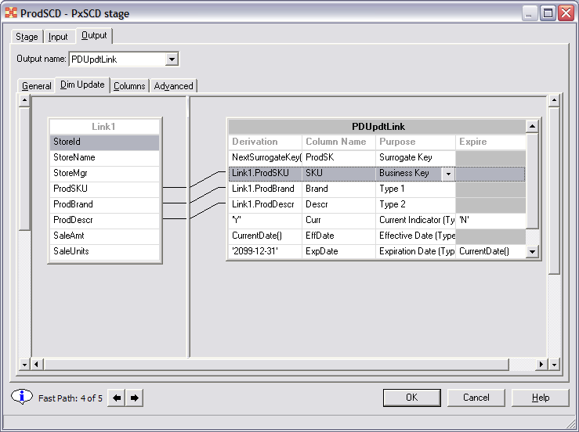
SCD (cont.) - Updating the Dimension Table
The Derivation column:
Indicates how to detect that a dimension row has changed.
  The action taken depends on the purpose code of the changed column. If it’s a Type1, then the row will need to be updated. If it is a Type2 the row needs to be expired and a new one created.
  Type2 changes are search for first.
Indicates how updated and new row values are to be computed

Slide 17
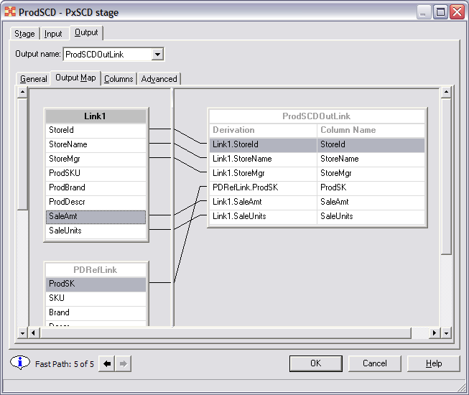
SCD (cont.) - Output Data
A familiar mapping screen is used to map columns to the output link.
Dimension table columns can also be mapped to the output. Since this is actually mapping data from the in-memory table, new rows and changed data are available to the output link.

Slide 18
Connectivity: Updates
The new connectors are easier to use and the new connectivity architecture will also make it easier for IBM to release new connectors and enhancements to them independent of a product (Data Stage) release.
New functionality and more DB supported in SQL builders
  SQL Server, Teradata, ODBC
New Stored Procedures functionality and for more DBs
  SQL Server, Teradata
Latest/Greatest version support (not all listed)
  DB2 9.1
  Oracle 10gR2
  SQL Server 2005
  Teradata v2r6.1 (DB server) / 8.1 (TTU)
  Sybase ASE 15, Sybase IQ 12.7
  Informix 10 (IDS)
  SAS 9.1
  IBM WS MQ 6.1, WS MB 5.1
  Netezza v3.1

Slide 19
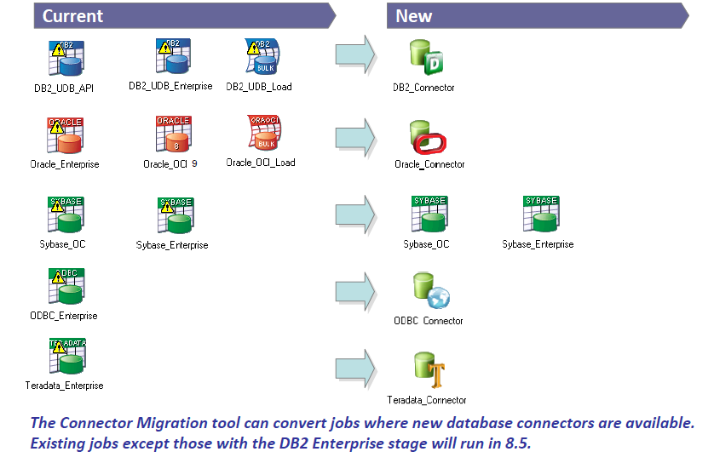
Connectivity: Updates
Any use, copying or distribution without written permission from UnitedHealth Group is prohibited.

Slide 20
Connectivity: New
Stages for WebSphere Federation Server and Classic Federation Server for z/os
  Server and Enterprise stages
  DRS Support
  Native integration with Federation and Classic Federation
Netezza Enterprise Stage
  Parallel Loader leveraging NZ_Load and External Tables
SFTP Enterprise Stage
  Secure data transmission
iWay Enterprise Stage
  Integration with over 250 disparate/legacy sources

Slide 21
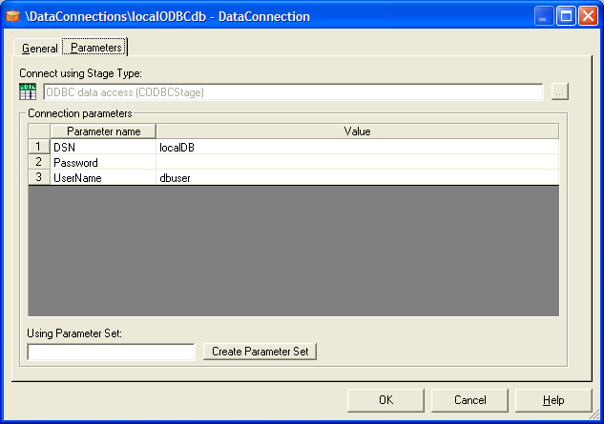
Connectivity: Connection Objects
New top-level repository object
Allows saving of a re-usable connection path to a specific source or target
  Username, password, db name etc.
Supported on specific stagetypes
  New Common Connectors
  Enterprise Stages: DB2, Informix, Oracle, Teradata
  For Plug-ins…
  For Server built-ins
    ODBC, UniVerse, UniData

Slide 22

Connectivity: Enterprise Packs Updates
New Validations for enterprise apps versions
  SAP ECC 6.0
  SAP BI 7.0
  Siebel 7.8
  JD Edwards EnterpriseOne 8.12
New SAP Unicode Certifications
  BW-STA 3.5 : Staging BAPI certification for BW Load
  BW-OHS 3.5 : Open-Hub service certification for BW Extract
  CA-ALE 4.0 : IDoc Load and Extract supports Web AS 6.40
  IA-BAPI : BAPI Load and Extract supports Web AS 6.40
New Functionality
  Enhanced support for Siebel EIM and Business Components
  New Metadata browser and importer for Oracle Applications
  Greater support for large enterprise class deployments
Notes:
These enhancements increase our appeal to ERP centric IT groups.

Slide 23
Connectivity: Goals of Next Generation “Rich” Connectors
One mechanism to access data from same source/target
  Supports DataStage Enterprise Editions & Information Analyzer
Fewer connectors
Ease of use
Connectors easier to develop - improved and consistent interfaces
Repeatability - template for new connectors
Consistent functionality across connectors
Extended functionality
Performance
DBMS Version management
Common Connectors supercede DS SE plug-ins and DS EE Operators, however, they can co-exist

Slide 24
Connectivity: Next Generation “Rich” Connectors
  Combining the best of the plug-ins, operators, plus more....
ODBC
  Embedded DataDirect v5.2 Connect for ODBC drivers
DB2 – 3Q07
  For DPF and non-DPF
Teradata – 2Q07
  New support for Teradata Parallel Transport (TPT)
Oracle – 4Q07
  New support for 10gR2
WebSphere MQ – 1Q07
  Adding support for “client only” configuration

Slide 25
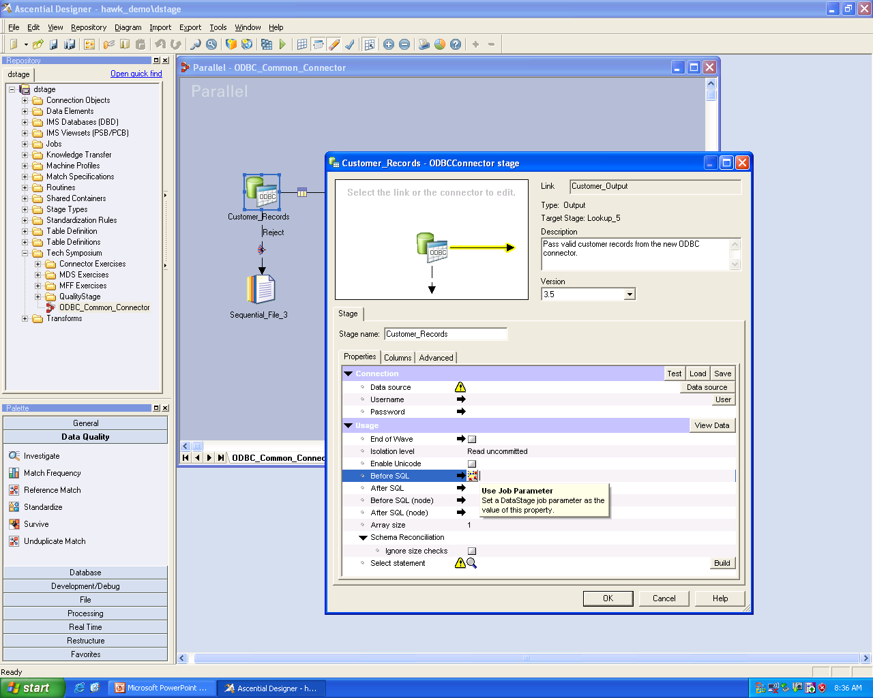
Connectivity: Next Generation “Rich” Connectors (cont.)
Connection objects allow properties to be dropped onto stage
Test the connection instantly
Diagram lets you select the link to edit as though your on the canvas
Parameter button on every field
Warning sign tells you which fields are mandatory
Graphical SQL builder

Slide 26

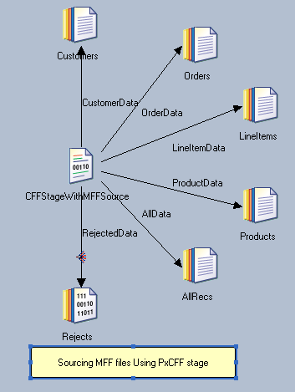
Connectivity: CFF Stage – Multi-Format Record Support
CFF stage now processes Multi Format Flat (MFF) file
Constraints can be specified on the output links to filter data and/or define when a record should be sent down the link

Slide 27
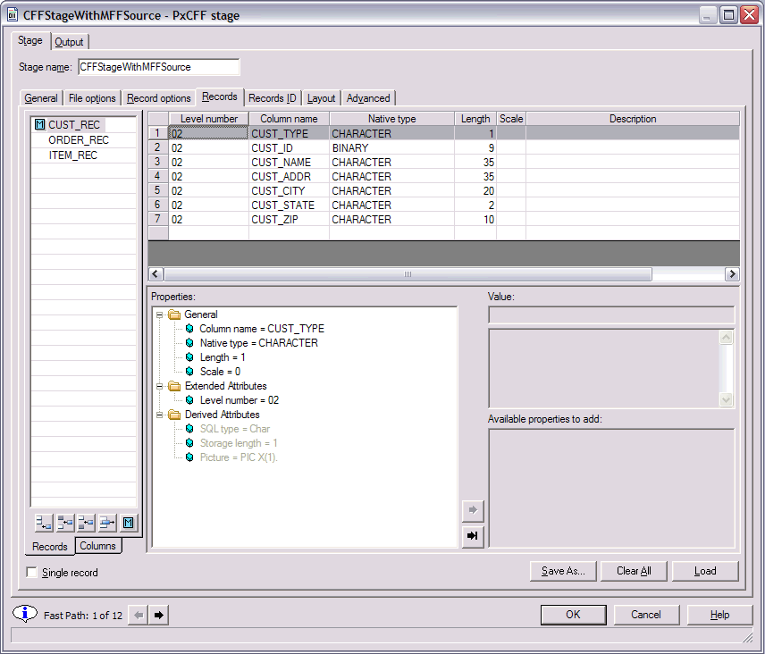
Connectivity: CFF Stage (cont.) – Select the type of format
Uncheck for MFF file source
Use the right or left arrow to navigate through the pages where user action is required

Slide 28
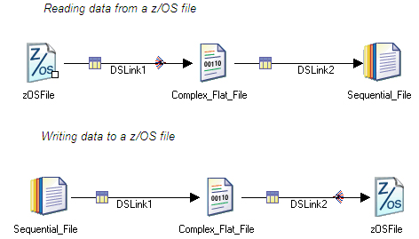
.
Z/OS File Stage
This stage makes it easier to process complex flat files by providing native support for mainframe files. We can use it for VSAM files – KSDS, ESDS, RRDS. Sequential QSAM, BDAM, BSAM. Fixed and variable length records. Single or multiple record type files.
Any use, copying or distribution without written permission from UnitedHealth Group is prohibited.

Slide 29
Netezza Integrations
Netezza Enterprise stage is a database stage. You can use this stage to write bulk data to Netezza Performance Server(NPS). The Netezza Enterprise stage uses the Netezza write operator (nzwrite) to write data to Netezza Performance Server. The Netezza write operator employs two alternate methods to load data to Netezza Performance Server. You can write data to a Netezza Performance Server database either by using a nzload load utility or by writing data to an external table before writing it to the database.
Any use, copying or distribution without written permission from UnitedHealth Group is prohibited.

Slide 30
Other new stages
Below are a few other less used but important stages introduced in 8.0.1, 8.5 and then in 8.7 versions
Bloom filter stage
Bloom Filter stage is based on the algorithm developed by Burton Howard Bloom and provides highly performance and resource efficient duplicate key filtering. This is particularly useful in Telco data integration patterns involving the enormous volumes of call detail records. It can be used to perform key lookups more efficiently. You might find false positives but Bloom Filter never generates false negatives in your output dataset. Bloom Filter Stage takes a single input dataset, and can generate multiple output sets depending on the operating mode.
Checksum stage -
This stage is used generate a checksum value from the specified columns in a row and add the checksum to the row. You can use the checksum value to check the validity of each row when it is written to the data target. If the checksum value does not equate to the columns from which it was generated, then the data is corrupt and is no longer valid.
Any use, copying or distribution without written permission from UnitedHealth Group is prohibited.

Slide 31
Dataset Stage enhancement
A dataset stage can now specify what to do if columns defined in the stage are not present in the data set when the job runs. One of the following can be selected:
Ignore - The job fails. If runtime column propagation is off, the job warns at the Data Set stage. The job fails when that column is explicitly used by another stage.
Fail - The job fails at the Data Set stage, regardless of whether runtime column propagation is on or off.
Default Nullable Only - The job sets any missing columns that are marked as nullable to the null value. Any missing columns marked as not nullable will cause the job to fail.
Default Non-Nullable Only - The job sets any missing columns that are marked as not nullable to the default value for that data type (for example, an integer column defaults to 0). Any missing columns marked as nullable will cause the job to fail.
Default All - The job sets values for missing columns as follows:
a.Nullable columns are set to null.
b. Non-nullable columns are set to the default value for that data type (for example, an integer column defaults to 0).
Any use, copying or distribution without written permission from UnitedHealth Group is prohibited.

Slide 32
Pivot Stage to Pivot Enterprise Stage
Pivot Enterprise stage can Pivot both vertically and horizontally. In earlier versions, vertical pivot was not available but with the introduction of Pivot Index in 8.x versions, Vertical Pivot is easily possible
A Vertical pivoting stage in the Enterprise Pivot stage is available to map a set of rows in the input data to single or multiple output columns
Any use, copying or distribution without written permission from UnitedHealth Group is prohibited.

Slide 33
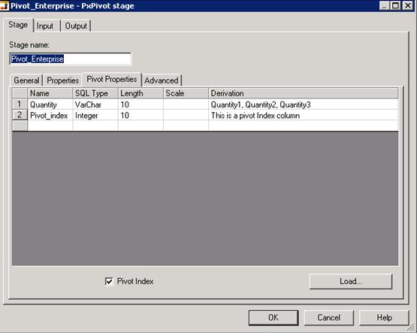
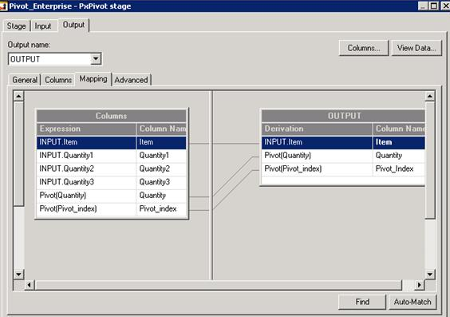
Pivot Stage to Pivot Enterprise Stage
Any use, copying or distribution without written permission from UnitedHealth Group is prohibited.

Slide 34
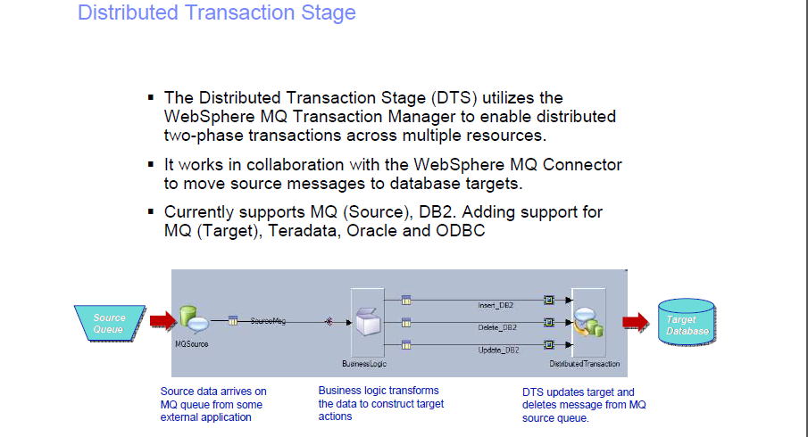
Any use, copying or distribution without written permission from UnitedHealth Group is prohibited.

